Slide 1
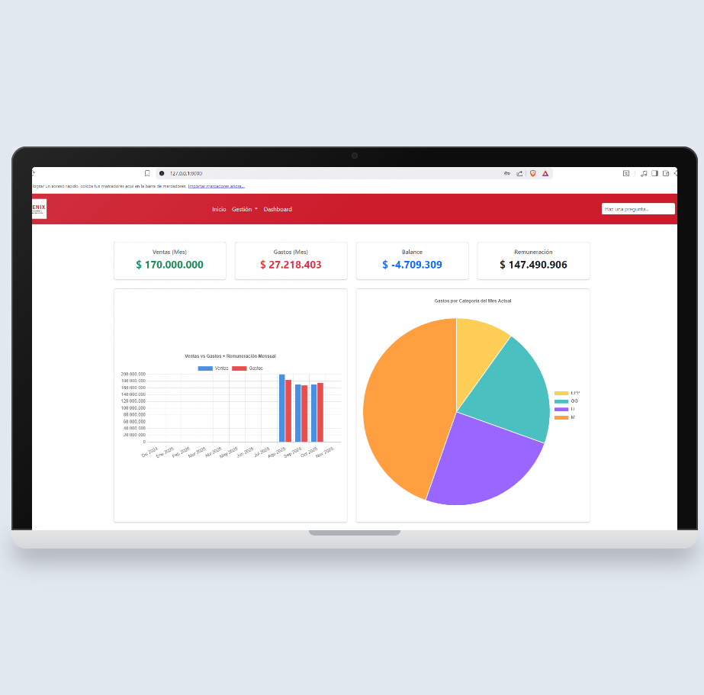
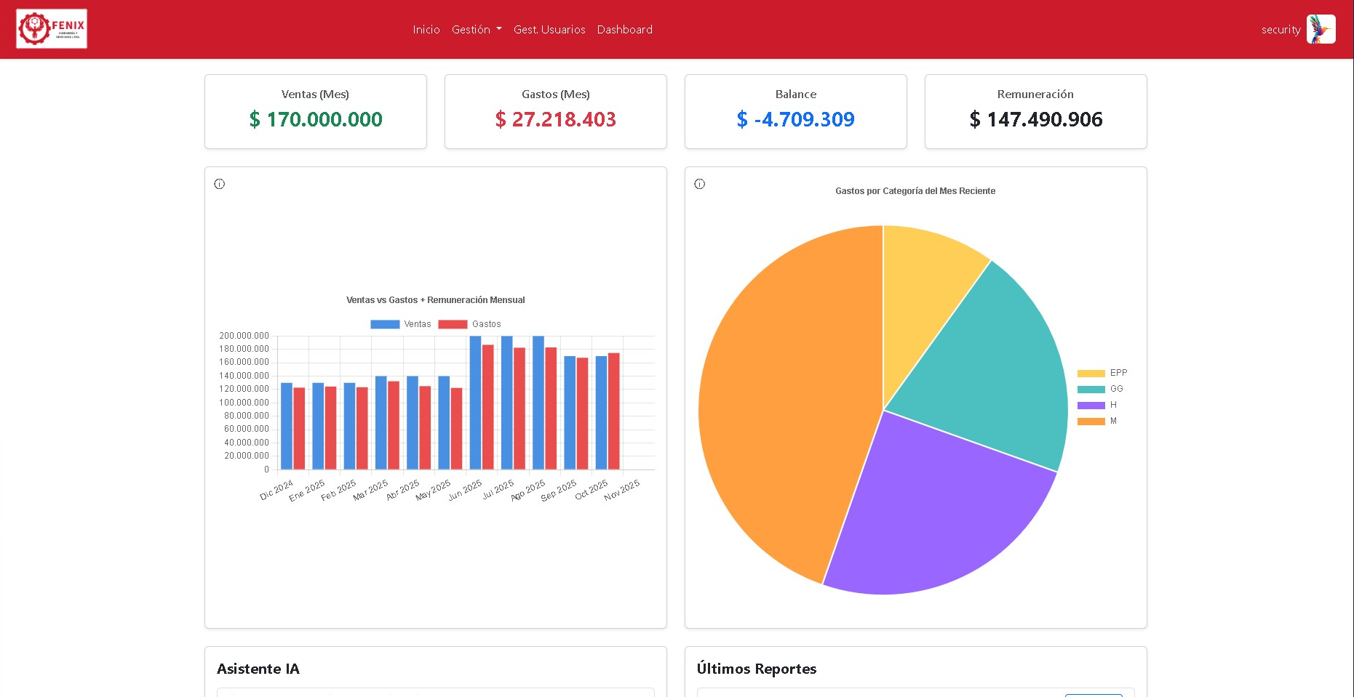

InsightDox: Intelligent Document Management Platform
Team Members: Maikel Cisternas y Marcelo Peña
Company: Fenix Ingeniería y Servicios Ltda.
Professor: Cristian Molina Pedernera
Course: PTY4614-005D

Slide 2
Developed Competencies
Requirements gathering and analysis.
Development, adaptation, and/or integration of computer systems.
Development of technological solutions.
Software quality assurance.
Project management.
Information management.
Teamwork.
Problem-solving.

Slide 3

The current Challenge
Dispersed Information
Limited Access
Data managed independently, preventing a real-time view.
Data shared upon request, causing operational delays.
Slow Decisions
Without real-time updates, decisions are delayed.
Risks of duplication, information loss, and high operational costs.

Slide 4
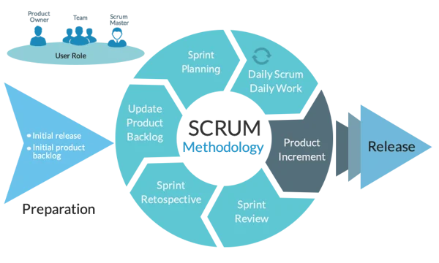
Methodology

Slide 5
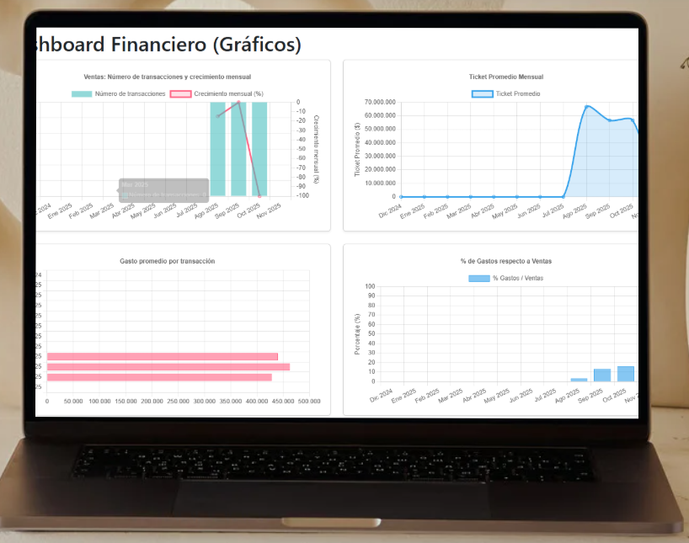
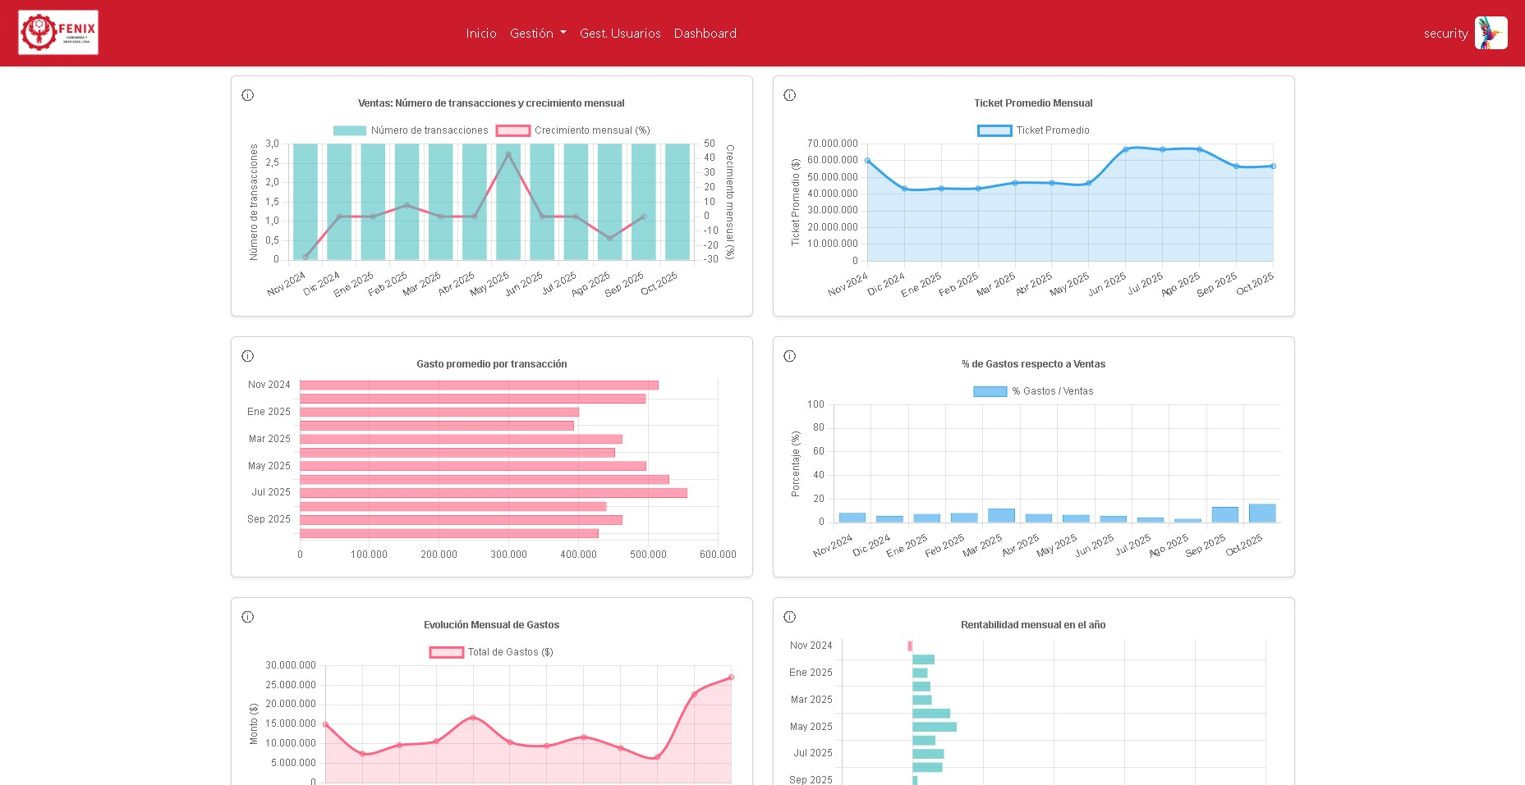
Proposed Solution: InsightDox
Centralized Platform with AI
Functional Requirements (What does it do?) | Non-Functional Requirements (How does it do it?)
Analysis and Intelligence | Robustness and Scalability
* Historical data queries (totals, averages) assisted by AI. | * Availability and Fault Tolerance (maintain operation despite non-critical failures).
* Expense or trend prediction for the next month | * Scalability to increase users, reports, and AI capacity without restructuring.
Management and Data | Seguridad y Confidencialidad
* Complete CRUD for Cost Reports and Users (with security roles). | * Secure Integration with Cloud services (GCS and Compute Engine).
* Centralized DB storage in MariaDB. | * Confidentiality of reports only for authorized users.
Interaction and Usability | Performance and Compatibility
* Clear success and error notifications in forms and operations. | * Adequate performance under high load and acceptable response times.
* Secure Password Recovery flow via email link. | * Full compatibility with main browsers (Chrome, Edge, Firefox, Opera).

Slide 6




Strategic Objectives: A Direct Approach to Our Challenges
Intuitive and Transparent Architecture
Unified Data Integration
Efficient modules for smooth import and export of critical business information.
Clear interface design for effective visualization of data and historical trends.
Empowering Artificial Intelligence
Enhanced Security and Confidentiality
Intelligent search, advanced analysis, and scenario prediction for proactive decision-making.
Protection and confidentiality of information through robust security protocols.
Assured Validation and Quality
Comprehensive testing of usability, performance, and security to ensure maximum quality and reliability before implementation.

Slide 7
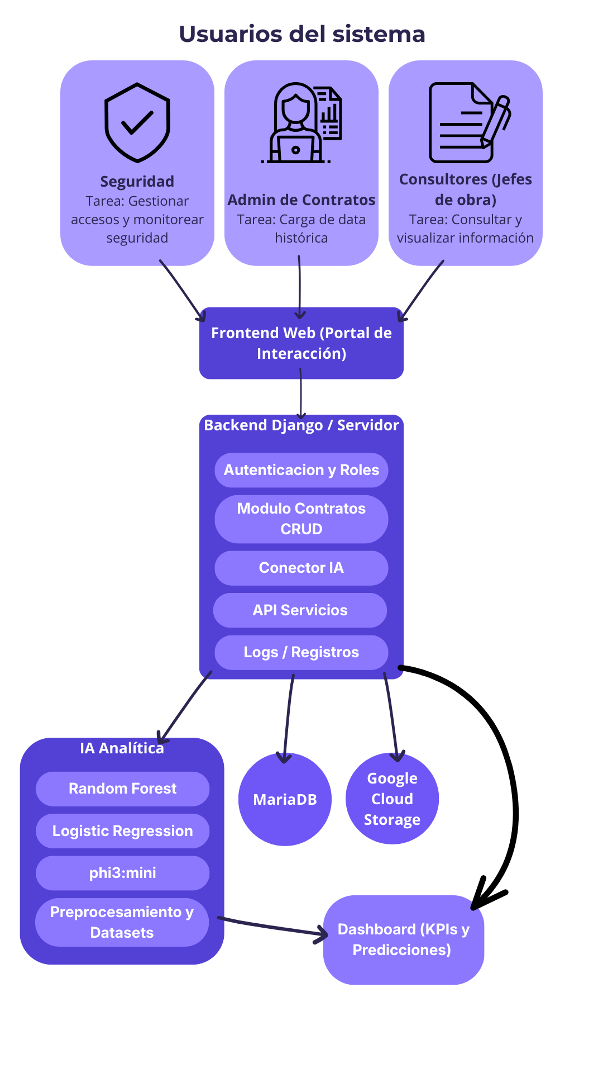




Solución Técnica
Robust and scalable architecture for integration, data analysis, security, and efficient usability.
Backend and Data Base
Full-Stack: Django 5.2.6, Data Base: MariaDB/MySQL.
AI, Analysis, and Processing
IA: phi3:mini, RandomForestRegressor, LogisticRegression, scikit-learn, pandas
Security and Role Management
Security: Security: Django Auth with 3 main roles: Contract Administrator, Security, and Consultant.
Frontend and Utilities
Frontend: Bootstrap 5 + JavaScript. Cloud Storage: Google Cloud Storage.

Slide 8
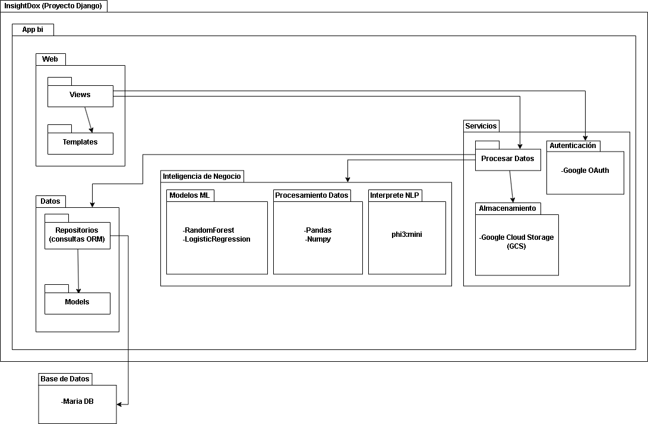
Package Diagram

Slide 9
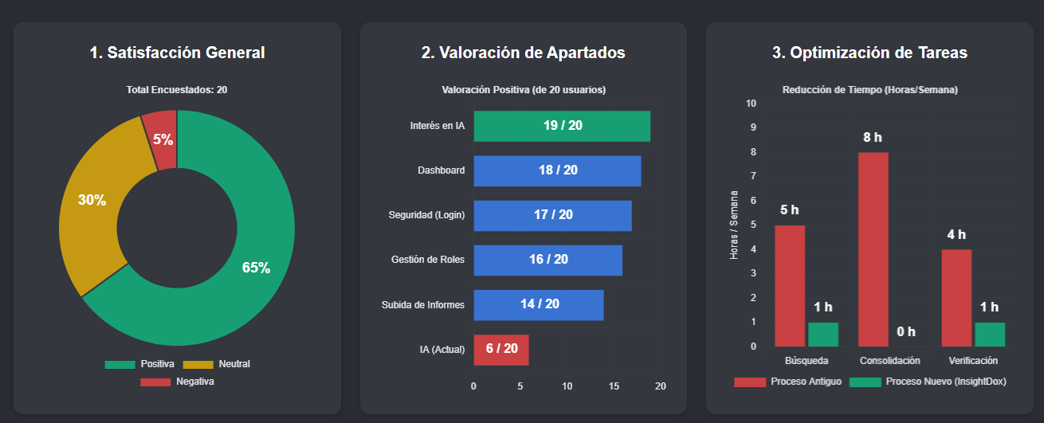
Satisfaction Results (Simulated)
Survey of 20 Key Users (Administrators and Managers) of Fenix Engineering

Slide 10
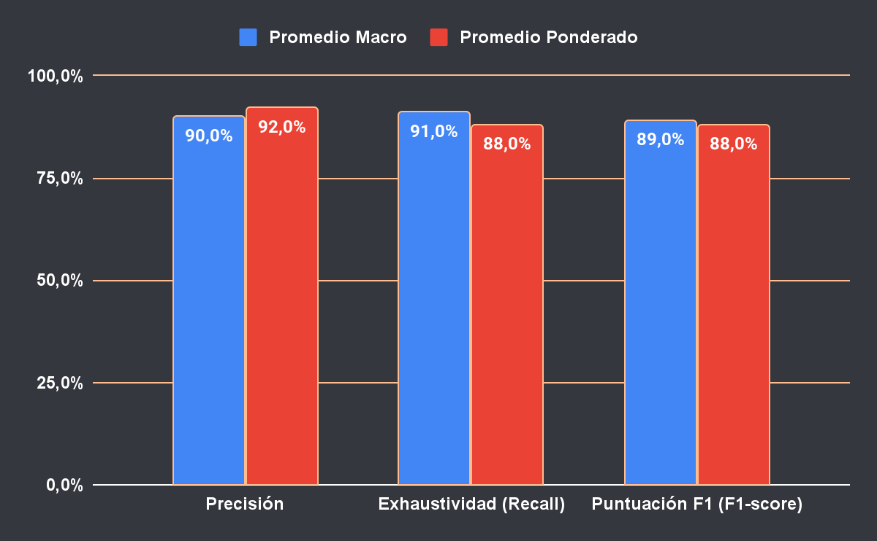

Validation Results
5-7
Prediction Accuracy
AI Response Time
Rating: Acceptable (simulated data)
5-7 seconds (optimal servers): Acceptable
Funcionalidad sólida demostrada. Margen de mejora en precisión predictiva una vez se incorporen datos reales.

Slide 11




GitHub
Future Projections
Project Expansion and Evolution
Strategic Client Acquisition
Identification of companies with centralization and document management needs.
Expansion with Inventory Management
Integration of stock control and advanced logistics module.
Continuous AI Optimization
Refinement of AI algorithms with real data for greater accuracy.

